Slide 1
Introduction to Probability Distributions

Slide 2
Random Variable
A random variable x takes on a defined set of values with different probabilities.
    For example, if you roll a die, the outcome is random (not fixed) and there are 6 possible outcomes, each of which occur with probability one-sixth.
    For example, if you poll people about their voting preferences, the percentage of the sample that responds “Yes on Proposition 100” is a also a random variable (the percentage will be slightly differently every time you poll).
Roughly, probability is how frequently we expect different outcomes to occur if we repeat the experiment over and over (“frequentist” view)

Slide 3
Random variables can be discrete or continuous
Discrete random variables have a countable number of outcomes
  Examples: Dead/alive, treatment/placebo, dice, counts, etc.
Continuous random variables have an infinite continuum of possible values.
  Examples: blood pressure, weight, the speed of a car, the real numbers from 1 to 6.

Slide 4
Probability functions
A probability function maps the possible values of x against their respective probabilities of occurrence, p(x)
p(x) is a number from 0 to 1.0.
The area under a probability function is always 1.
Notes:
It turns out that if you were to go out and sample many, many times, most sample statistics that you could calculate would follow a normal distribution.
What are the 2 parameters (from last time) that define any normal distribution?
Remember that a normal curve is characterized by two parameters, a mean and a variability (SD)
What do you think the mean value of a sample statistic would be? The standard deviation?
Remember standard deviation is natural variability of the population
Standard error can be standard error of the mean or standard error of the odds ratio or standard error of the difference of 2 means, etc. The standard error of any sample statistic.

Slide 5
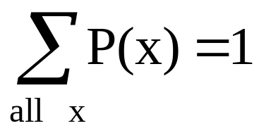
Discrete example: roll of a die
p(x)
1/6
x
1
2
3
4
5
6

Slide 6
Probability mass function (pmf)
x
p(x)
1
p(x=1)=1/6
2
p(x=2)=1/6
3
p(x=3)=1/6
4
p(x=4)=1/6
5
p(x=5)=1/6
6
p(x=6)=1/6
1.0

Slide 7
Cumulative distribution function (CDF)
1.0
P(x)
5/6
2/3
1/2
1/3
1/6
1
2
3
4
5
6
x

Slide 8
Cumulative distribution function
x
P(x≤A)
1
P(x≤1)=1/6
2
P(x≤2)=2/6
3
P(x≤3)=3/6
4
P(x≤4)=4/6
5
P(x≤5)=5/6
6
P(x≤6)=6/6

Slide 9
Practice Problem:
The number of patients seen in the ER in any given hour is a random variable represented by x. The probability distribution for x is:
x
10
11
12
13
14
P(x)
.4
.2
.2
.1
.1
Find the probability that in a given hour:
a. exactly 14 patients arrive
b. At least 12 patients arrive
c. At most 11 patients arrive
p(x=14)= .1
p(x≥12)= (.2 + .1 +.1) = .4
p(x≤11)= (.4 +.2) = .6

Slide 10
Review Question 1
If you toss a die, what’s the probability that you roll a 3 or less?
1/6
1/3
1/2
5/6
1.0

Slide 11
Review Question 1
If you toss a die, what’s the probability that you roll a 3 or less?
1/6
1/3
1/2
5/6
1.0

Slide 12
Review Question 2
Two dice are rolled and the sum of the face values is six? What is the probability that at least one of the dice came up a 3?
1/5
2/3
1/2
5/6
1.0

Slide 13
Review Question 2
Two dice are rolled and the sum of the face values is six. What is the probability that at least one of the dice came up a 3?
1/5
2/3
1/2
5/6
1.0
How can you get a 6 on two dice? 1-5, 5-1, 2-4, 4-2, 3-3
One of these five has a 3.
∴1/5

Slide 14
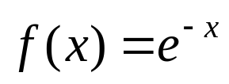
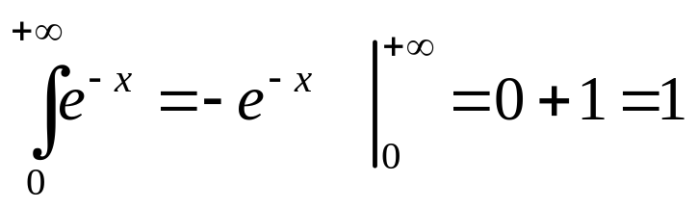
Continuous case
The probability function that accompanies a continuous random variable is a continuous mathematical function that integrates to 1.
  For example, recall the negative exponential function (in probability, this is called an “exponential distribution”):
  This function integrates to 1:

Slide 15
Continuous case: “probability density function” (pdf)
p(x)=e^{-x}
1
x
The probability that x is any exact particular value (such as 1.9976) is 0; we can only assign probabilities to possible ranges of x.

Slide 16
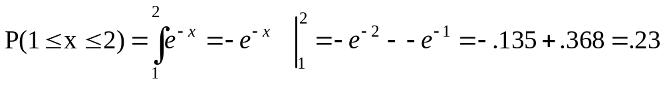
For example, the probability of x falling within 1 to 2:
Clinical example: Survival times after lung transplant may roughly follow an exponential function.
Then, the probability that a patient will die in the second year after surgery (between years 1 and 2) is 23%.
p(x)=e^{-x}
1
x
1
2

Slide 17
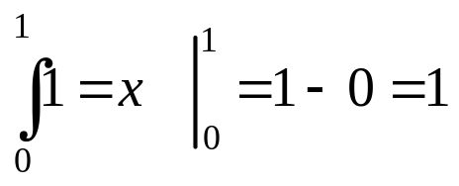
Example 2: Uniform distribution
The uniform distribution: all values are equally likely.
f(x)= 1 , for 1≥ x ≥0
p(x)
1
x
1
We can see it’s a probability distribution because it integrates to 1 (the area under the curve is 1):

Slide 18
Example: Uniform distribution
What’s the probability that x is between 0 and ½?
p(x)
Clinical Research Example: When randomizing patients in an RCT, we often use a random number generator on the computer. These programs work by randomly generating a number between 0 and 1 (with equal probability of every number in between). Then a subject who gets X<.5 is control and a subject who gets X>.5 is treatment.
1
0
½
x
1
P(½ ≥x≥ 0)= ½

Slide 19
Expected Value and Variance
All probability distributions are characterized by an expected value (mean) and a variance (standard deviation squared).

Slide 20
Expected value of a random variable
Expected value is just the average or mean (µ) of random variable x.
It’s sometimes called a “weighted average” because more frequent values of X are weighted more highly in the average.
It’s also how we expect X to behave on-average over the long run (“frequentist” view again).

Slide 21
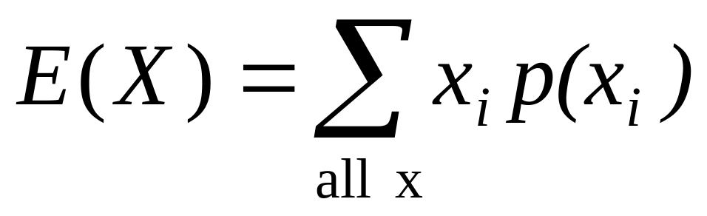
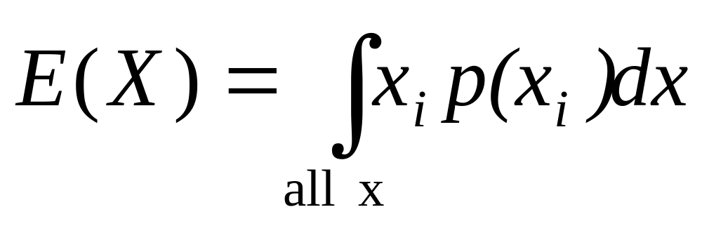
Expected value, formally
Discrete case:
Continuous case:

Slide 22
Symbol Interlude
E(X) = µ
  these symbols are used interchangeably

Slide 23
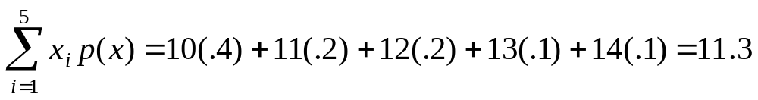
Example: expected value
Recall the following probability distribution of ER arrivals:
x
10
11
12
13
14
P(x)
.4
.2
.2
.1
.1

Slide 24
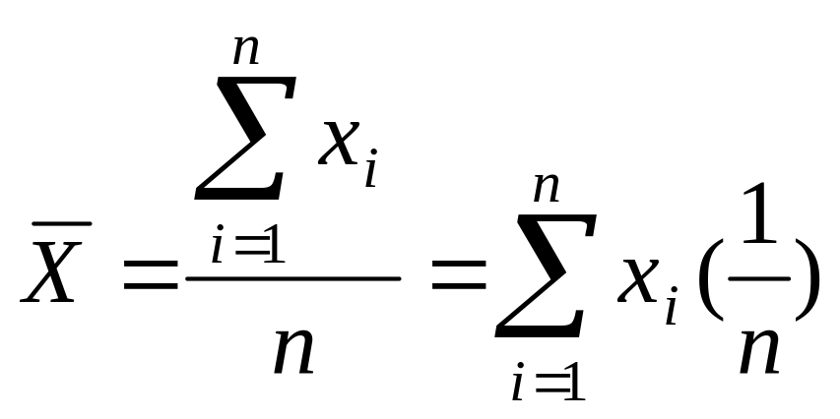
Sample Mean is a special case of Expected Value…
Sample mean, for a sample of n subjects: =
The probability (frequency) of each person in the sample is 1/n.

Slide 25
Expected Value
Expected value is an extremely useful concept for good decision-making!

Slide 26
Example: the lottery
The Lottery (also known as a tax on people who are bad at math…)
A certain lottery works by picking 6 numbers from 1 to 49. It costs $1.00 to play the lottery, and if you win, you win $2 million after taxes.
If you play the lottery once, what are your expected winnings or losses?

Slide 27
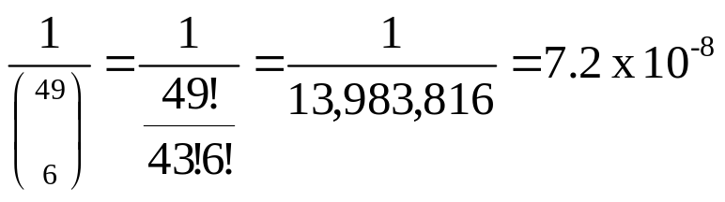
Lottery
Calculate the probability of winning in 1 try:
“49 choose 6”
Out of 49 numbers, this is the number of distinct combinations of 6.
The probability function (note, sums to 1.0):
x$
p(x)
-1
.999999928
+ 2 million
7.2 x 10⁻⁻⁸

Slide 28
Expected Value
The probability function
x$
p(x)
-1
.999999928
+ 2 million
7.2 x 10⁻⁻⁸
Expected Value
E(X) = P(win)*$2,000,000 + P(lose)*-$1.00
= 2.0 x 10⁶ * 7.2 x 10⁻⁸+ .999999928 (-1) = .144 - .999999928 = -$.86
Negative expected value is never good!
You shouldn’t play if you expect to lose money!

Slide 29
Expected Value
If you play the lottery every week for 10 years, what are your expected winnings or losses?
520 x (-.86) = -$447.20

Slide 30
Gambling (or how casinos can afford to give so many free drinks…)
A roulette wheel has the numbers 1 through 36, as well as 0 and 00. If you bet $1 that an odd number comes up, you win or lose $1 according to whether or not that event occurs. If random variable X denotes your net gain, X=1 with probability 18/38 and X= -1 with probability 20/38.
E(X) = 1(18/38) – 1 (20/38) = -$.053
On average, the casino wins (and the player loses) 5 cents per game.
The casino rakes in even more if the stakes are higher:
E(X) = 10(18/38) – 10 (20/38) = -$.53
If the cost is $10 per game, the casino wins an average of 53 cents per game. If 10,000 games are played in a night, that’s a cool $5300.

Slide 31
Expected value isn’t everything though…
Take the hit new show “Deal or No Deal”
Everyone know the rules?
Let’s say you are down to two cases left. $1 and $400,000. The banker offers you $200,000.
So, Deal or No Deal?

Slide 32
Deal or No Deal…
This could really be represented as a probability distribution and a non-random variable:
x$
p(x)
+1
.50
+$400,000
.50
x$
p(x)
+$200,000
1.0

Slide 33

Expected value doesn’t help…
x$
p(x)
+1
.50
+$400,000
.50
x$
p(x)
+$200,000
1.0

Slide 34
How to decide?
Variance!
If you take the deal, the variance/standard deviation is 0.
If you don’t take the deal, what is average deviation from the mean?
What’s your gut guess?

Slide 35
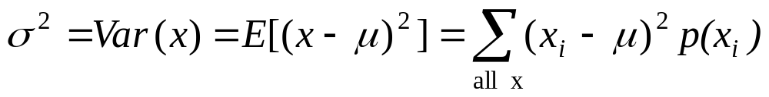
Variance/standard deviation
σ²=Var(x) =E(x-μ)²
“The expected (or average) squared distance (or deviation) from the mean”

Slide 36
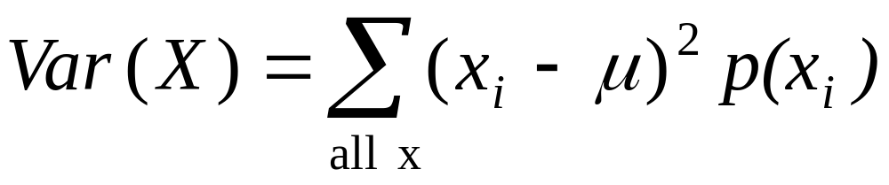
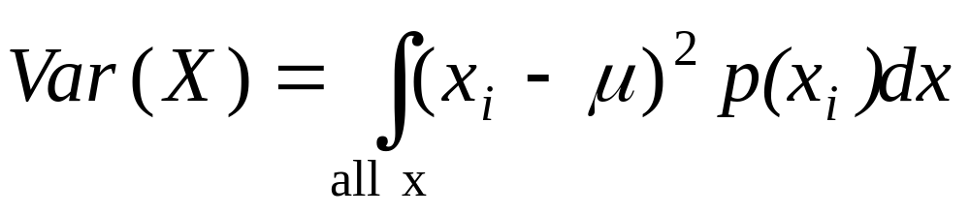
Variance, continuous
Discrete case:
Continuous case?:

Slide 37
Symbol Interlude
Var(X)= σ²
SD(X) = σ
  these symbols are used interchangeably

Slide 38
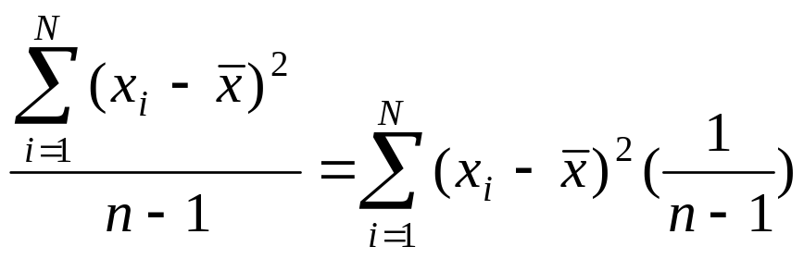
Similarity to empirical variance
The variance of a sample: s² =
Division by n-1 reflects the fact that we have lost a “degree of freedom” (piece of information) because we had to estimate the sample mean before we could estimate the sample variance.

Slide 39
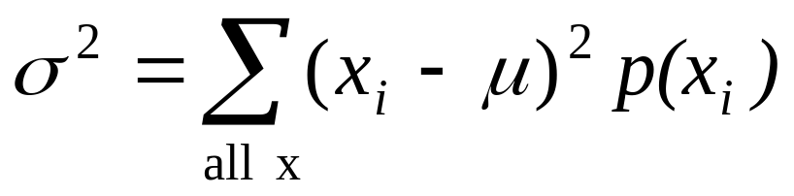
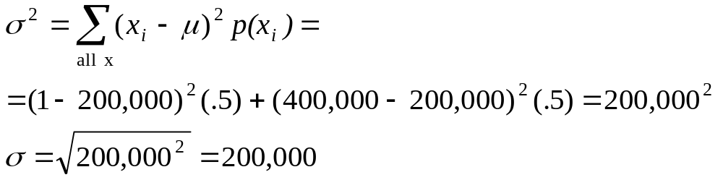
Variance
Now you examine your personal risk tolerance…

Slide 40
Practice Problem
On the roulette wheel, X=1 with probability 18/38 and X= -1 with probability 20/38.
  We already calculated the mean to be = -$.053. What’s the variance of X?

Slide 41
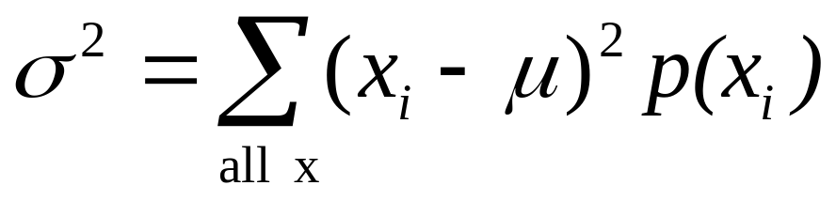
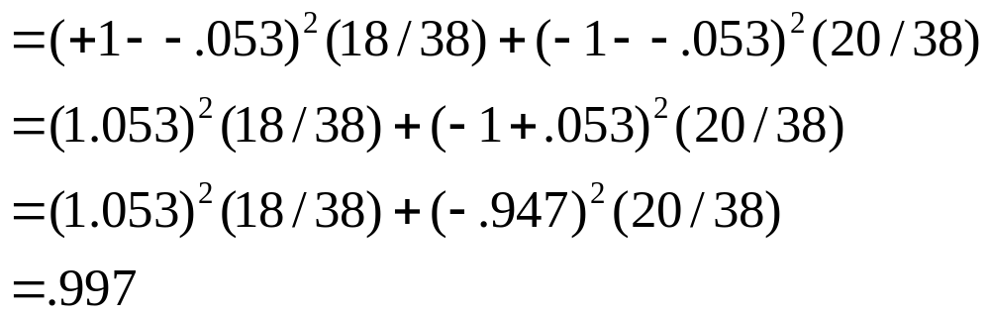
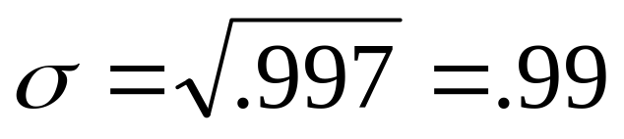
Answer
Standard deviation is $.99. Interpretation: On average, you’re either 1 dollar above or 1 dollar below the mean, which is just under zero. Makes sense!

Slide 42
Review Question 3
The expected value and variance of a coin toss (H=1, T=0) are?
.50, .50
.50, .25
.25, .50
.25, .25

Slide 43
Review Question 3
The expected value and variance of a coin toss are?
.50, .50
.50, .25
.25, .50
.25, .25

Slide 44
Important discrete probability distribution: The binomial

Slide 45
Binomial Probability Distribution
A fixed number of observations (trials), n
  e.g., 15 tosses of a coin; 20 patients; 1000 people surveyed
A binary outcome
  e.g., head or tail in each toss of a coin; disease or no disease
  Generally called “success” and “failure”
  Probability of success is p, probability of failure is 1 – p
Constant probability for each observation
  e.g., Probability of getting a tail is the same each time we toss the coin

Slide 46
Binomial distribution
Take the example of 5 coin tosses. What’s the probability that you flip exactly 3 heads in 5 coin tosses?

Slide 47
Binomial distribution
Solution:
One way to get exactly 3 heads: HHHTT
What’s the probability of this exact arrangement?
P(heads)xP(heads) xP(heads)xP(tails)xP(tails) =(1/2)³ x (1/2)²
Another way to get exactly 3 heads: THHHT
Probability of this exact outcome = (1/2)¹ x (1/2)³ x (1/2)¹ = (1/2)³ x (1/2)²

Slide 48
Binomial distribution
In fact, (1/2)³ x (1/2)² is the probability of each unique outcome that has exactly 3 heads and 2 tails.
So, the overall probability of 3 heads and 2 tails is:
(1/2)³ x (1/2)² + (1/2)³ x (1/2)² + (1/2)³ x (1/2)² + ….. for as many unique arrangements as there are—but how many are there??

Slide 49
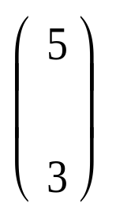
Outcome Probability
THHHT (1/2)³ x (1/2)²
HHHTT (1/2)³ x (1/2)²
TTHHH (1/2)³ x (1/2)²
HTTHH (1/2)³ x (1/2)²
HHTTH (1/2)³ x (1/2)²
HTHHT (1/2)³ x (1/2)²
THTHH (1/2)³ x (1/2)²
HTHTH (1/2)³ x (1/2)²
HHTHT (1/2)³ x (1/2)²
THHTH (1/2)³ x (1/2)²
10 arrangements x (1/2)³ x (1/2)²
The probability of each unique outcome (note: they are all equal)
ways to arrange 3 heads in 5 trials
₅C₃ = 5!/3!2! = 10
Factorial review: n! = n(n-1)(n-2)…

Slide 50
∴P(3 heads and 2 tails) = x P(heads)³ x P(tails)² =
10 x (½)⁵⁼31.25%

Slide 51
Binomial distribution function:
X= the number of heads tossed in 5 coin tosses
p(x)
p(x)
x
0
1
2
3
4
5
number of heads
number of heads

Slide 52
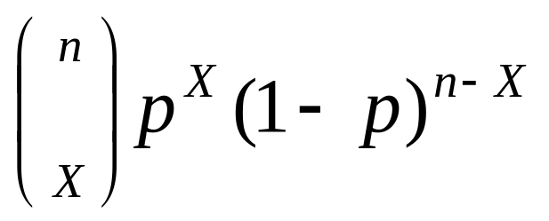
Binomial distribution, generally
Note the general pattern emerging → if you have only two possible outcomes (call them 1/0 or yes/no or success/failure) in n independent trials, then the probability of exactly X “successes”=
n = number of trials
1-p = probability of failure
X = # successes out of n trials
p = probability of success

Slide 53
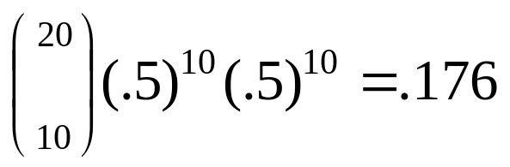
Binomial distribution: example
If I toss a coin 20 times, what’s the probability of getting exactly 10 heads?

Slide 54
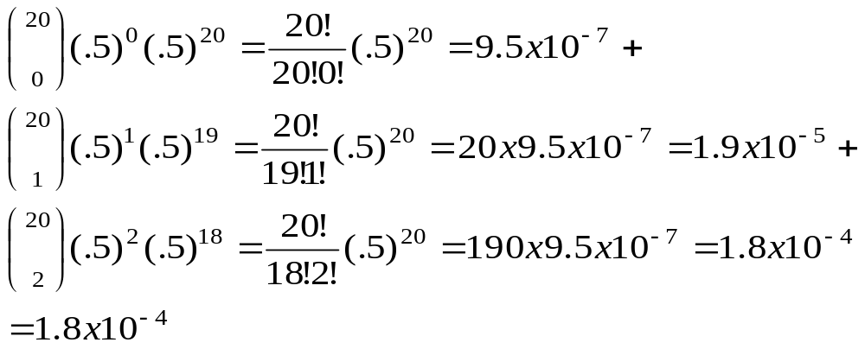
Binomial distribution: example
If I toss a coin 20 times, what’s the probability of getting of getting 2 or fewer heads?

Slide 55
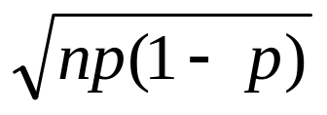
**All probability distributions are characterized by an expected value and a variance:
If X follows a binomial distribution with parameters n and p: X ~ Bin (n, p)
Then:
E(X) = np
Var (X) = np(1-p)
SD (X)=
Note: the variance will always lie between
0*N-.25 *N
p(1-p) reaches maximum at p=.5
P(1-p)=.25

Slide 56
Practice Problem
1. You are performing a cohort study. If the probability of developing disease in the exposed group is .05 for the study duration, then if you (randomly) sample 500 exposed people, how many do you expect to develop the disease? Give a margin of error (+/- 1 standard deviation) for your estimate.
2. What’s the probability that at most 10 exposed people develop the disease?

Slide 57
Answer
1. How many do you expect to develop the disease? Give a margin of error (+/- 1 standard deviation) for your estimate.
X ~ binomial (500, .05)
E(X) = 500 (.05) = 25
Var(X) = 500 (.05) (.95) = 23.75
StdDev(X) = square root (23.75) = 4.87
∴25 ± 4.87

Slide 58
Answer
2. What’s the probability that at most 10 exposed subjects develop the disease?
This is asking for a CUMULATIVE PROBABILITY: the probability of 0 getting the disease or 1 or 2 or 3 or 4 or up to 10.
P(X≤10) = P(X=0) + P(X=1) + P(X=2) + P(X=3) + P(X=4)+….+ P(X=10)=

Slide 59
Practice Problem:
You are conducting a case-control study of smoking and lung cancer. If the probability of being a smoker among lung cancer cases is .6, what’s the probability that in a group of 8 cases you have:
Less than 2 smokers?
More than 5?
What are the expected value and variance of the number of smokers?

Slide 60
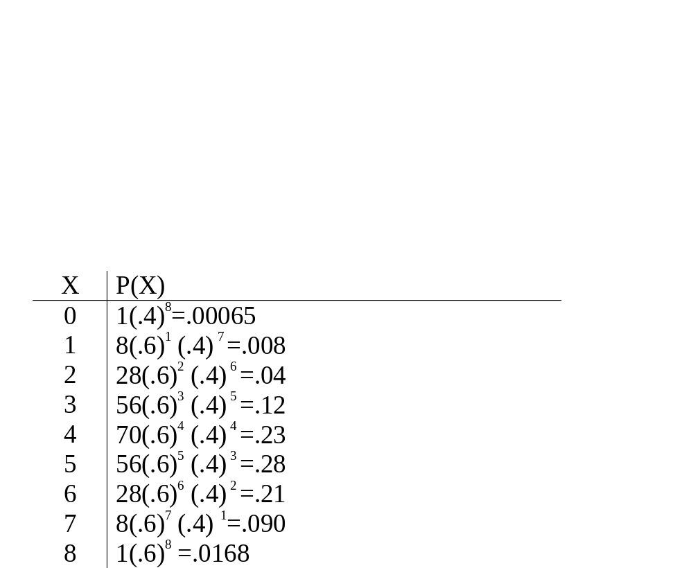
Answer
0
1
2
3
4
5
6
7
8

Slide 61
Answer, continued
P(<2)=.00065 + .008 = .00865
P(>5)=.21+.09+.0168 = .3168
0
1
2
3
4
5
6
7
8
E(X) = 8 (.6) = 4.8
Var(X) = 8 (.6) (.4) =1.92
StdDev(X) = 1.38

Slide 62
Review Question 4
In your case-control study of smoking and lung-cancer, 60% of cases are smokers versus only 10% of controls. What is the odds ratio between smoking and lung cancer?
2.5
13.5
15.0
6.0
.05

Slide 63
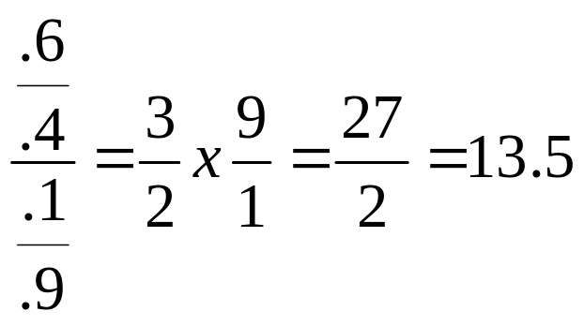
Review Question 4
In your case-control study of smoking and lung-cancer, 60% of cases are smokers versus only 10% of controls. What is the odds ratio between smoking and lung cancer?
2.5
13.5
15.0
6.0
.05

Slide 64
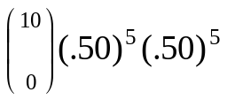
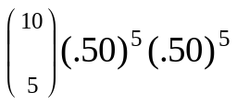
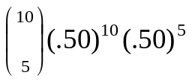
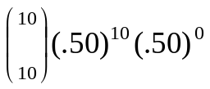
Review Question 5
What’s the probability of getting exactly 5 heads in 10 coin tosses?

Slide 65
Review Question 5
What’s the probability of getting exactly 5 heads in 10 coin tosses?

Slide 66
Review Question 6
A coin toss can be thought of as an example of a binomial distribution with N=1 and p=.5. What are the expected value and variance of a coin toss?
.5, .25
1.0, 1.0
1.5, .5
.25, .5
.5, .5

Slide 67
Review Question 6
A coin toss can be thought of as an example of a binomial distribution with N=1 and p=.5. What are the expected value and variance of a coin toss?
.5, .25
1.0, 1.0
1.5, .5
.25, .5
.5, .5

Slide 68
Review Question 7
If I toss a coin 10 times, what is the expected value and variance of the number of heads?
5, 5
10, 5
2.5, 5
5, 2.5
2.5, 10

Slide 69
Review Question 7
If I toss a coin 10 times, what is the expected value and variance of the number of heads?
5, 5
10, 5
2.5, 5
5, 2.5
2.5, 10

Slide 70
Review Question 8
In a randomized trial with n=150, the goal is to randomize half to treatment and half to control. The number of people randomized to treatment is a random variable X. What is the probability distribution of X?
X~Normal(μ=75,σ=10)
X~Exponential(μ=75)
X~Uniform
X~Binomial(N=150, p=.5)
X~Binomial(N=75, p=.5)

Slide 71
Review Question 8
In a randomized trial with n=150, every subject has a 50% chance of being randomized to treatment. The number of people randomized to treatment is a random variable X. What is the probability distribution of X?
X~Normal(μ=75,σ=10)
X~Exponential(μ=75)
X~Uniform
X~Binomial(N=150, p=.5)
X~Binomial(N=75, p=.5)

Slide 72
Review Question 9
In the same RCT with n=150, if 69 end up in the treatment group and 81 in the control group, how far off is that from expected?
Less than 1 standard deviation
1 standard deviation
Between 1 and 2 standard deviations
More than 2 standard deviations

Slide 73
Review Question 9
In the same RCT with n=150, if 69 end up in the treatment group and 81 in the control group, how far off is that from expected?
Less than 1 standard deviation
1 standard deviation
Between 1 and 2 standard deviations
More than 2 standard deviations
Expected = 75
81 and 69 are both 6 away from the expected.
Variance = 150(.25) = 37.5
Std Dev ≅ 6
Therefore, about 1 SD away from expected.

Slide 74
Proportions…
The binomial distribution forms the basis of statistics for proportions.
A proportion is just a binomial count divided by n.
  For example, if we sample 200 cases and find 60 smokers, X=60 but the observed proportion=.30.
Statistics for proportions are similar to binomial counts, but differ by a factor of n.

Slide 75
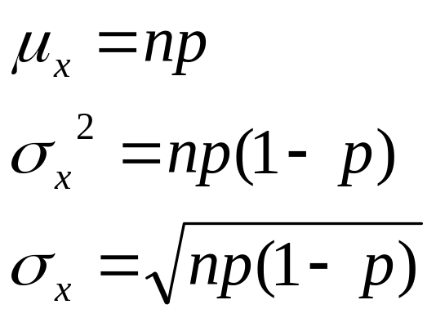
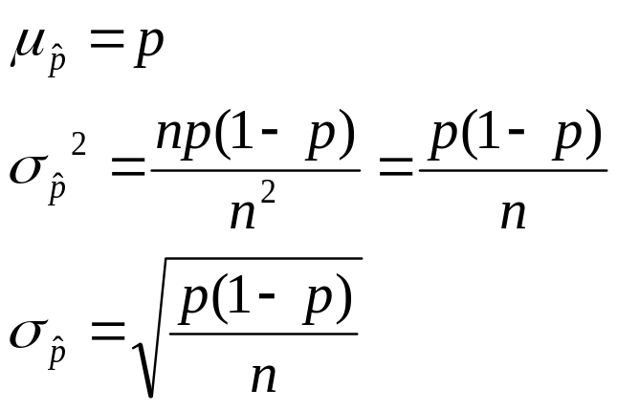
Stats for proportions
For binomial:
Differs by a factor of n.
Differs by a factor of n.
For proportion:
P-hat stands for “sample proportion.”

Slide 76
It all comes back to normal…
Statistics for proportions are based on a normal distribution, because the binomial can be approximated as normal if np>5

